Slide 1
The Central Limit Theorem (CLT)

Slide 2
Central Limit Theorem (CLT)
Problem: Suppose population data does not follow normal distribution (i.e. it is left/right-skewed)
Population->Samples
Example: 10 lakh examination result of students->500 samples of 100 students each
For each sample, calculate average marks (Sample mean or x̄)
Plot these sample means on a graph
They will follow normal distribution: Central Limit Theorem (CLT)
Generally, minimum sample size = 30
How many such samples? No such number
Result: Consider original population also as normally distributed now

Slide 3
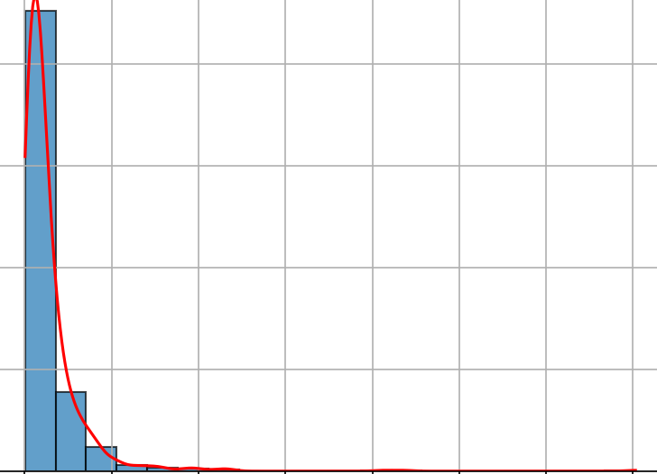
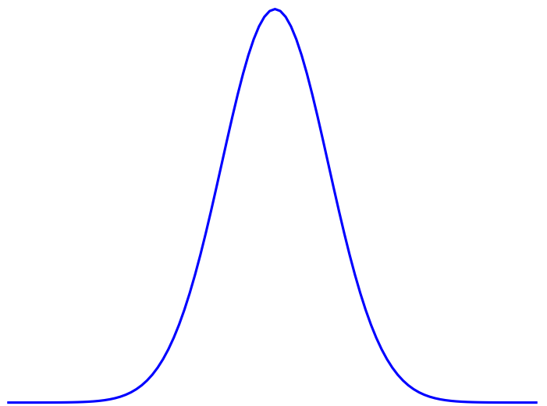
CLT
Population
Sample 1
Sample 2
Sample 3
..
Sample n
Sample mean
Sample mean
Sample mean
..
Sample mean

Slide 4
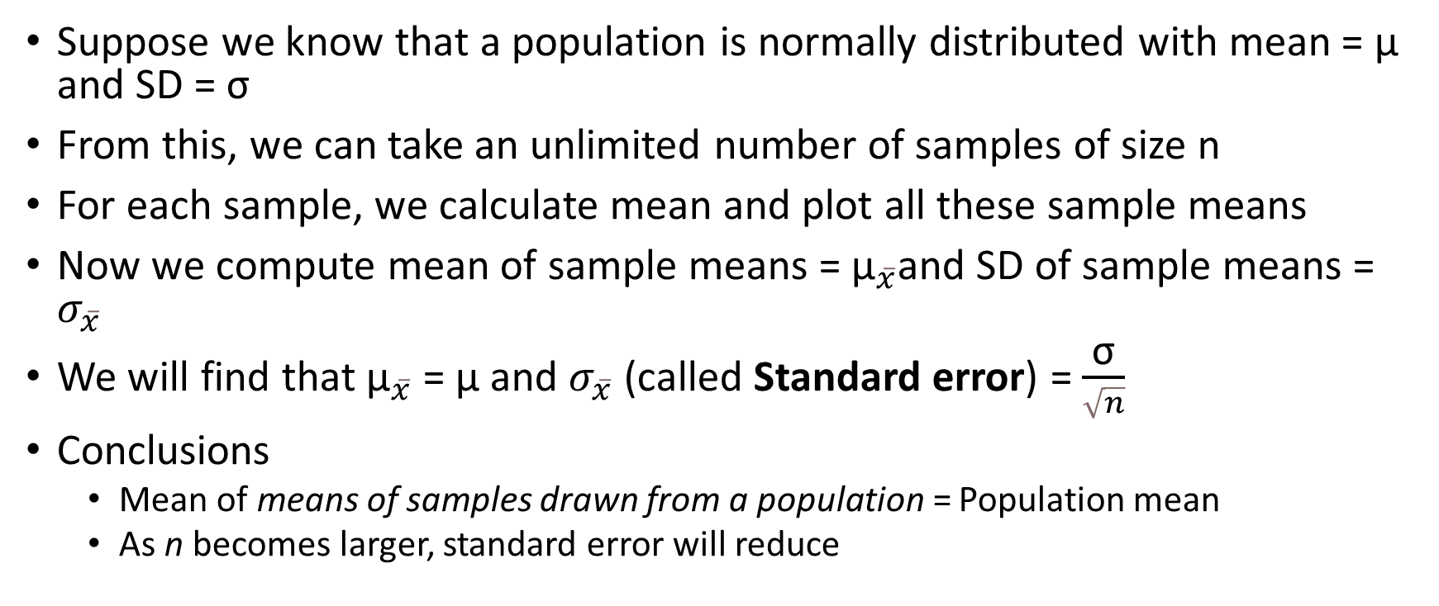
Sampling from a Normal Population
Suppose we know that a population is normally distributed with mean = μ and SD = σ
From this, we can take an unlimited number of samples of size n
For each sample, we calculate mean and plot all these sample means
Now we compute mean of sample means = ${\text{μ}}_{\overline{x}}$and SD of sample means = $σ_{\overline{x}}$
We will find that ${\text{μ}}_{\overline{x}}$ = μ and $σ_{\overline{x}}$ (called Standard error) = $\frac{\text{σ}}{\sqrt{n}}$
Conclusions
Mean of means of samples drawn from a population = Population mean
As n becomes larger, standard error will reduce

Slide 5
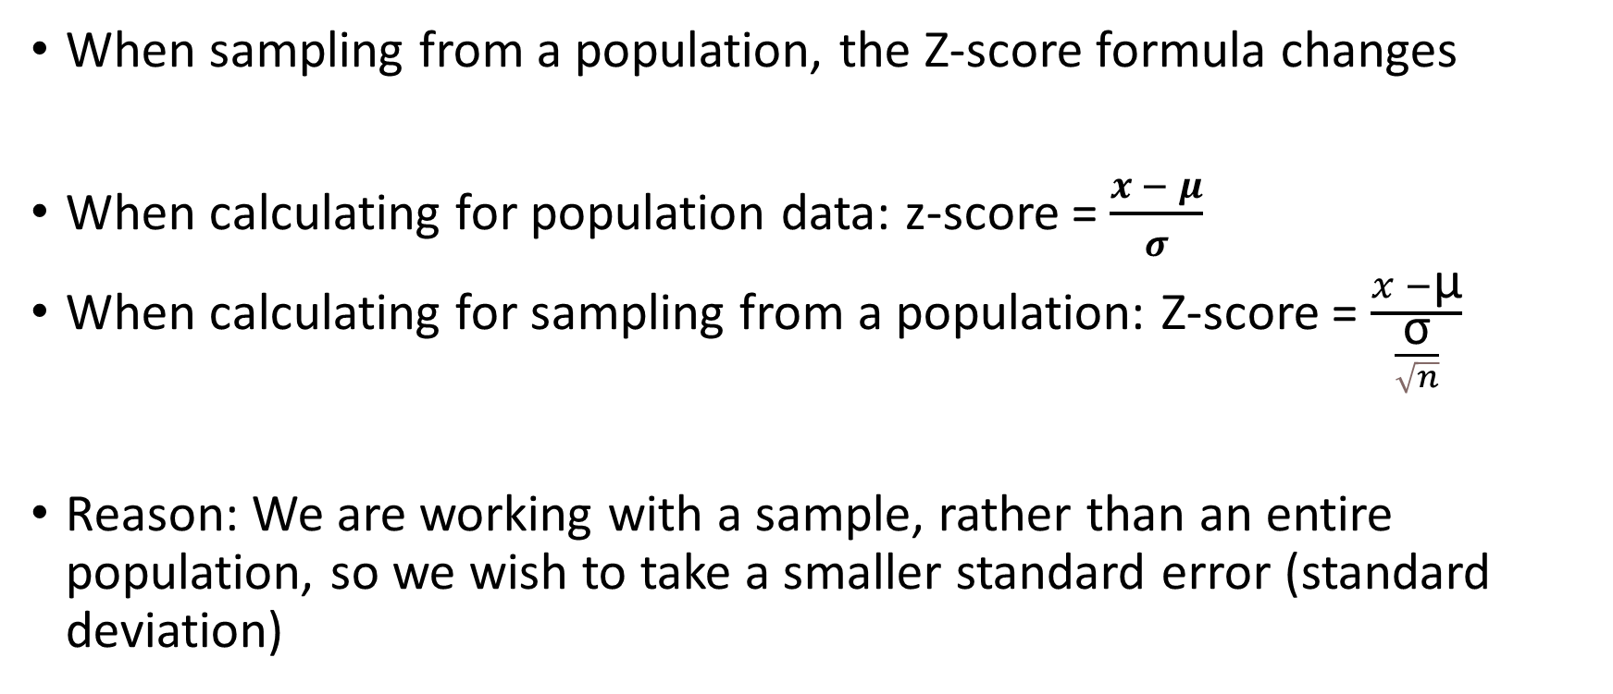
Z-Score Calculation
When sampling from a population, the Z-score formula changes
When calculating for population data: z-score =$\frac{x − μ}{σ}$
When calculating for sampling from a population: Z-score = $\frac{x −\text{μ}}{\frac{\text{σ}}{\sqrt{n}}}$
Reason: We are working with a sample, rather than an entire population, so we wish to take a smaller standard error (standard deviation)

Slide 6
More the Samples, Lesser the Error
Suppose a manufacturer ships goods in a box so that the weights of the boxes are normally distributed with a mean weight of 25 kg with a standard deviation of 4 kg. What is the impact of various sample sizes on the Z-score calculation, and hence the estimation?
Solution: Next slide
Key points
Precision of estimates: If we take a sample of (a) 5 boxes and calculate the average, (b) 100 boxes and calculate the average … option (b) will always give us more accurate results
Law of large numbers: With small samples, we have a risk of randomness/bad samples
CLT: As we have more samples, each having a larger sample size, the distribution of sample means approaches normal distribution

Slide 7
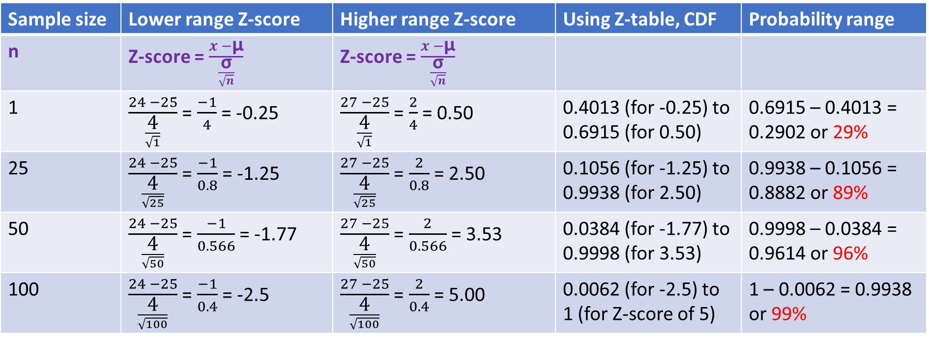
More Samples, Better Results
As the sample size increases, the probability that a box will weigh between 24 kg and 27 kg becomes even higher due to the reduced variability in the sample mean. This makes our predictions more accurate.
Sample size | Lower range Z-score | Higher range Z-score | Using Z-table, CDF | Probability range
n | Z-score = $\frac{x −\text{μ}}{\frac{\text{σ}}{\sqrt{n}}}$ | Z-score = $\frac{x −\text{μ}}{\frac{\text{σ}}{\sqrt{n}}}$
1 | $\frac{24 −25}{\frac{\text{4}}{\sqrt{1}}}$ = $\frac{−1}{4}$ = -0.25 | $\frac{27 −25}{\frac{\text{4}}{\sqrt{1}}}$ = $\frac{2}{4}$ = 0.50 | 0.4013 (for -0.25) to 0.6915 (for 0.50) | 0.6915 – 0.4013 = 0.2902 or 29%
25 | $\frac{24 −25}{\frac{\text{4}}{\sqrt{25}}}$ = $\frac{−1}{0.8}$ = -1.25 | $\frac{27 −25}{\frac{\text{4}}{\sqrt{25}}}$ = $\frac{2}{0.8}$ = 2.50 | 0.1056 (for -1.25) to 0.9938 (for 2.50) | 0.9938 – 0.1056 = 0.8882 or 89%
50 | $\frac{24 −25}{\frac{\text{4}}{\sqrt{50}}}$ = $\frac{−1}{0.566}$ = -1.77 | $\frac{27 −25}{\frac{\text{4}}{\sqrt{50}}}$ = $\frac{2}{0.566}$ = 3.53 | 0.0384 (for -1.77) to 0.9998 (for 3.53) | 0.9998 – 0.0384 = 0.9614 or 96%
100 | $\frac{24 −25}{\frac{\text{4}}{\sqrt{100}}}$ = $\frac{−1}{0.4}$ = -2.5 | $\frac{27 −25}{\frac{\text{4}}{\sqrt{100}}}$ = $\frac{2}{0.4}$ = 5.00 | 0.0062 (for -2.5) to 1 (for Z-score of 5) | 1 – 0.0062 = 0.9938 or 99%

Slide 8
Hypothesis Testing

Slide 9
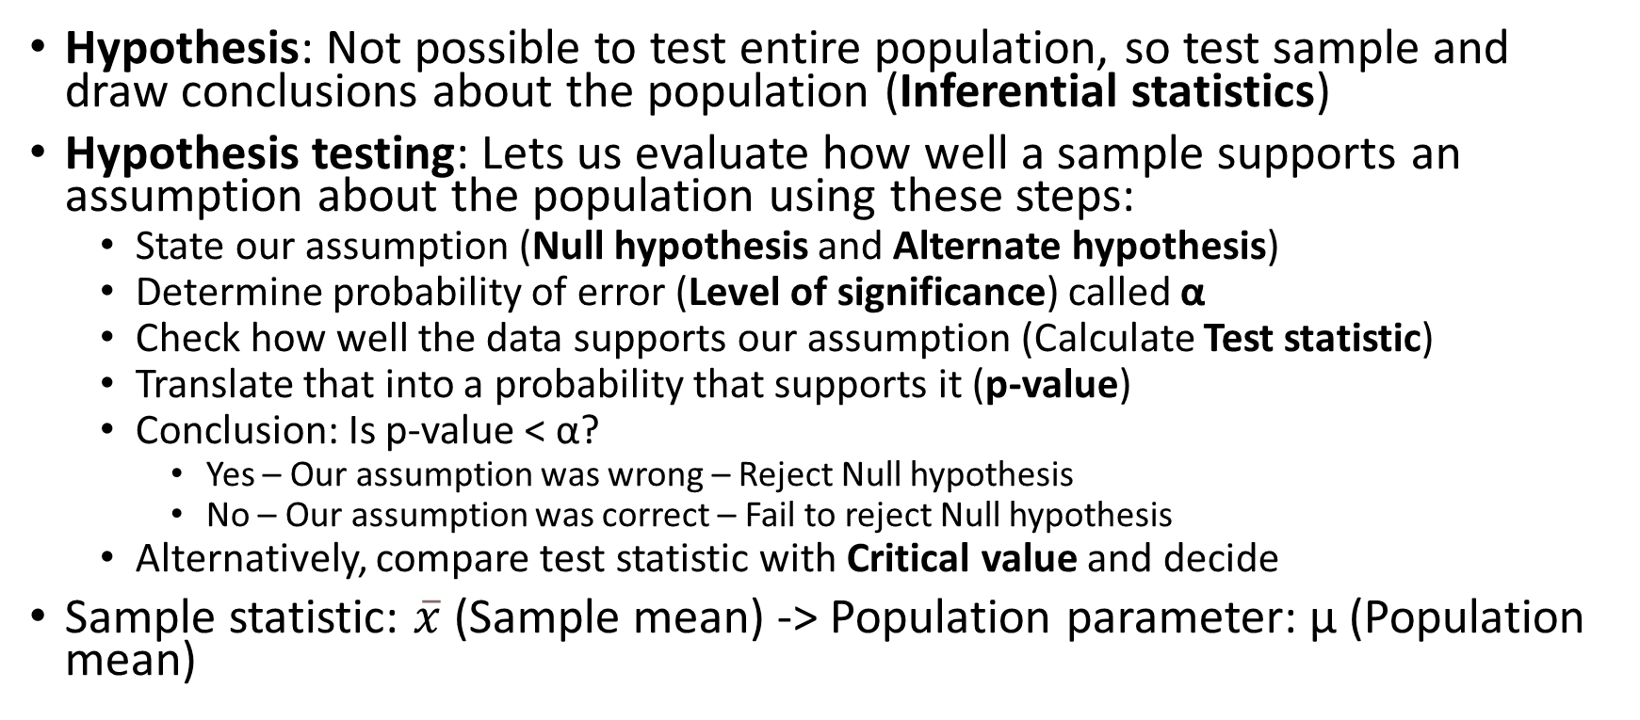
Hypothesis
Hypothesis: Not possible to test entire population, so test sample and draw conclusions about the population (Inferential statistics)
Hypothesis testing: Lets us evaluate how well a sample supports an assumption about the population using these steps:
State our assumption (Null hypothesis and Alternate hypothesis)
Determine probability of error (Level of significance) called α
Check how well the data supports our assumption (Calculate Test statistic)
Translate that into a probability that supports it (p-value)
Conclusion: Is p-value < α?
Yes – Our assumption was wrong – Reject Null hypothesis
No – Our assumption was correct – Fail to reject Null hypothesis
Alternatively, compare test statistic with Critical value and decide
Sample statistic: $\overline{x}$ (Sample mean) -> Population parameter: μ (Population mean)

Slide 10
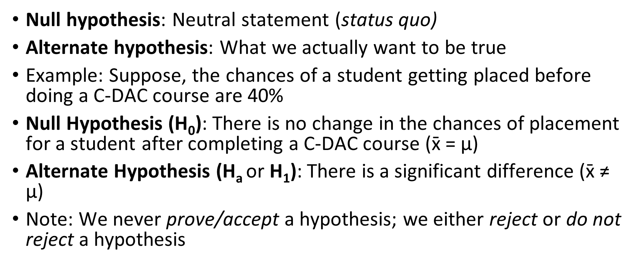
Null and Alternate Hypotheses
Null hypothesis: Neutral statement (status quo)
Alternate hypothesis: What we actually want to be true
Example: Suppose, the chances of a student getting placed before doing a C-DAC course are 40%
Null Hypothesis (H₀): There is no change in the chances of placement for a student after completing a C-DAC course ($\text{x}\text{̄}$= $\text{μ}$)
Alternate Hypothesis (H_{a} or H₁): There is a significant difference ($\text{x}\text{̄}$≠ $\text{μ}$)
Note: We never prove/accept a hypothesis; we either reject or do not reject a hypothesis

Slide 11
Significance Level (α) and p-value
α: What we set before a statistical test
p-value: What we calculate after the test
α = Significance level = Threshold or acceptable probability of rejecting the null hypothesis when it is actually true
Usually set to 5% (or 0.05)
Meaning: We are okay with a 5% chance of rejecting the null hypothesis incorrectly
p-value = Result of an actual test (Area of rejection)
Low p-value: Reject H₀, High p-value: Fail to reject H₀
So, we may start with α = 0.05, run a test, and calculate p-value
If p-value = 0.02, Reject H₀
If p-value = 0.10, Do not reject H₀
If p-value <= α … Reject H0
If p-value > α … Do not reject H0

Slide 12
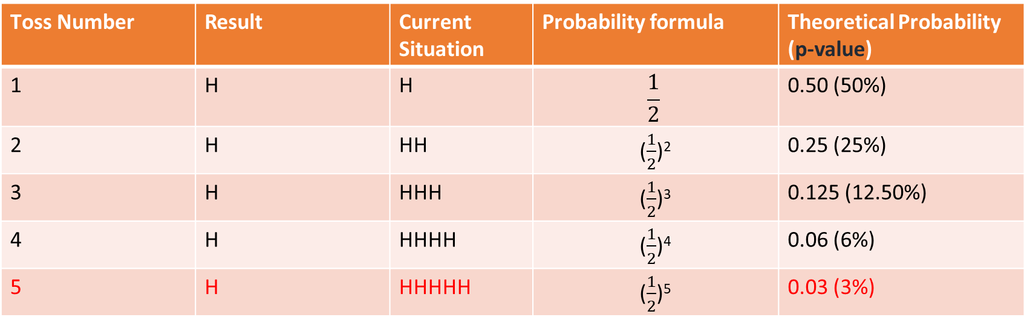
Significance Level (α) and p-value
Example: Tossing a coin with H₀ = Coin is fair and H₁: Coin is not fair
We toss it 5 times and each time we get a head! (See next slide for a bar plot)
At what point we conclude that the coin is not fair and reject H₀?
That is our significance level (α), usually set at 0.05 (i.e. 5%) or 0.10 (0r 10%) – Our Lakshman Rekha! Our p-value must be > α for us not to reject H₀
If we have set it at 5%, if we get a heads a fifth time, the p-value < α and we reject H₀
Toss Number | Result | Current Situation | Probability formula | Theoretical Probability (p-value)
1 | H | H | $$\frac{1}{2}$$ | 0.50 (50%)
2 | H | HH | ($\frac{1}{2}$)² | 0.25 (25%)
3 | H | HHH | ($\frac{1}{2}$)³ | 0.125 (12.50%)
4 | H | HHHH | ($\frac{1}{2}$)⁴ | 0.06 (6%)
5 | H | HHHHH | ($\frac{1}{2}$)⁵ | 0.03 (3%)

Slide 13
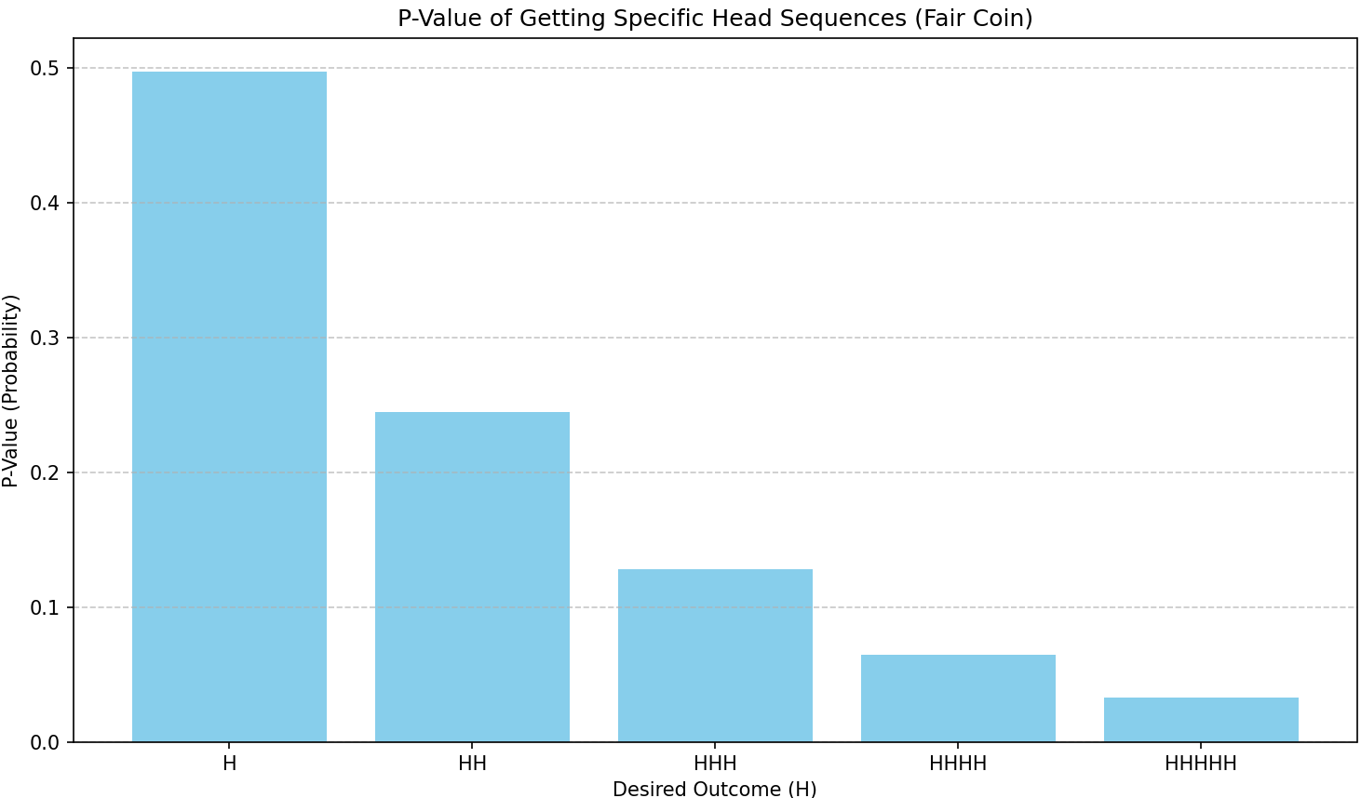
Visualizing p-value

Slide 14
Understanding p-value
p-value: Probability of obtaining a result at least as extreme as the observed one, assuming the null hypothesis is true
Helps us determine whether an observed result is due to random chance or if it is statistically significant
Example: Tossing a coin five times and counting the number of heads, repeat this say 100 times
We would expect HHHHH to occur about 3.125% of the time (i.e. approximately 3 times in 100 such experiments) due to random chance
But suppose we find that this is happening 10-15 times
Conclusion: Question if the coin is fair, since we expected it to be only about 3 times , due to random chance

Slide 15
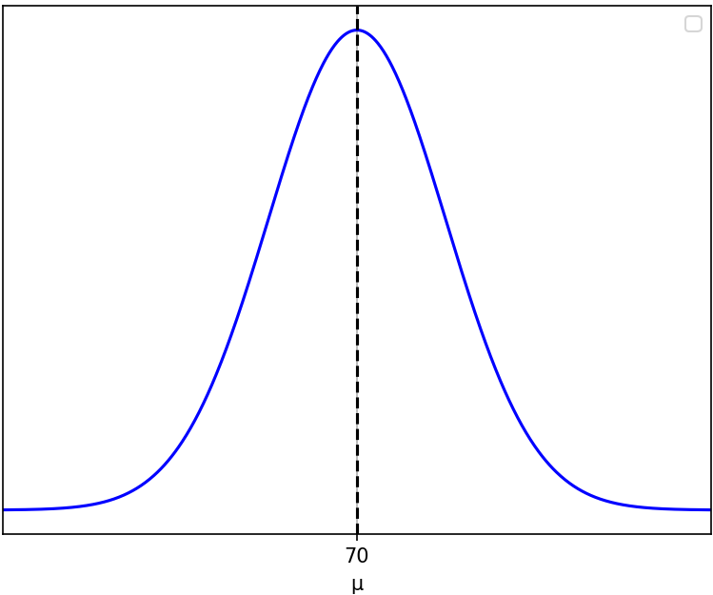
Significance Level (α) – More Details
Interesting point! Another definition of α: The probability of rejecting the null hypothesis even though it is true (Type I Error)
Why? What if the coin was indeed fair and showed HHHHH? – Very rare but possible!
We ended up rejecting H0 when we should not have! => Type I error
Another Example: A course head thinks average student score is 70%
H₀: Population mean score (μ) = 70%, H₁: Population mean score (μ) ≠ 70%
So, scores distribution should look like this

Slide 16
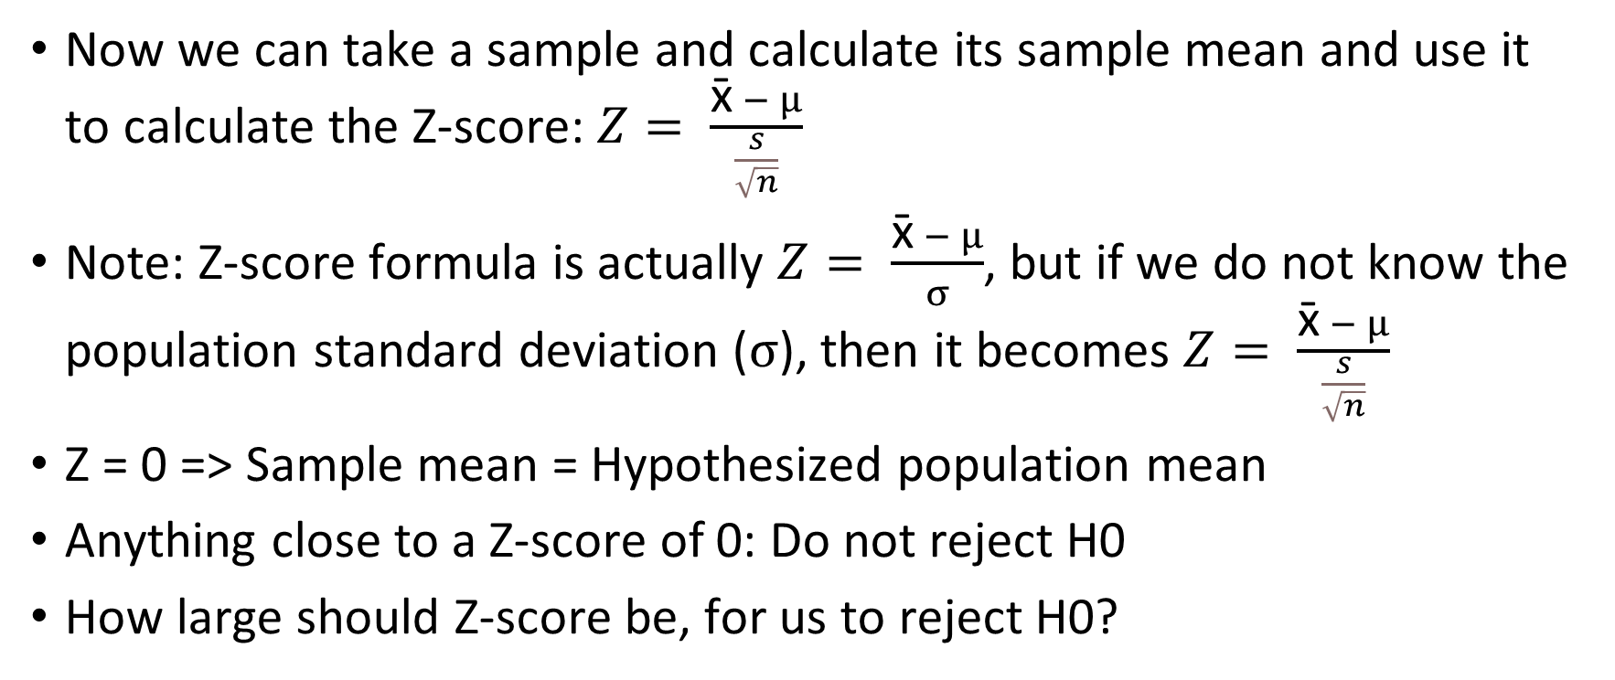
Significance Level
Now we can take a sample and calculate its sample mean and use it to calculate the Z-score: $Z= \frac{\text{x}\text{̄} − μ}{\frac{s}{\sqrt{n}}}$
Note: Z-score formula is actually $Z= \frac{\text{x}\text{̄} − μ}{σ}$, but if we do not know the population standard deviation ($σ$), then it becomes $Z= \frac{\text{x}\text{̄} − μ}{\frac{s}{\sqrt{n}}}$
Z = 0 => Sample mean = Hypothesized population mean
Anything close to a Z-score of 0: Do not reject H0
How large should Z-score be, for us to reject H0?

Slide 17
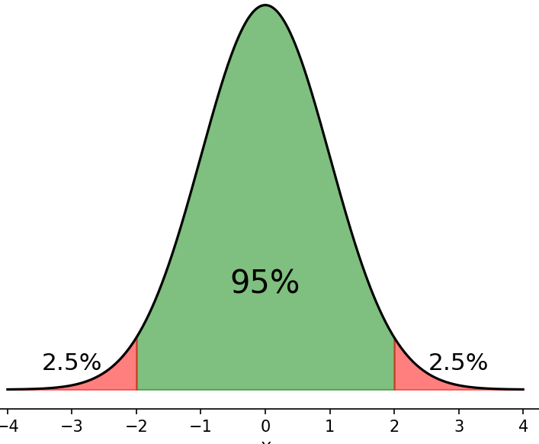
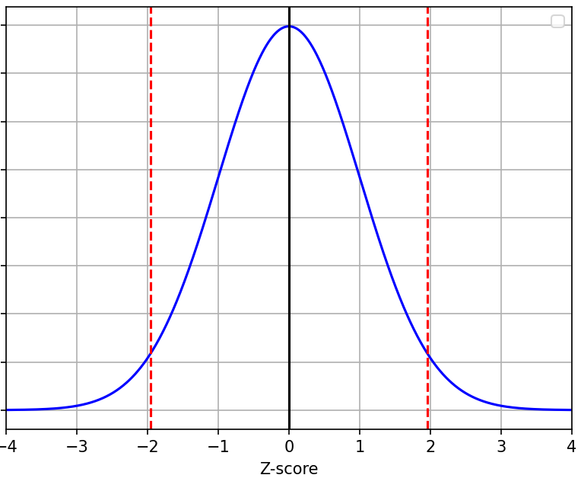
Significance Level
Critical values define the boundaries of the non-rejection zone for Z-scores … If our Z-score crosses this zone on either side, we reject H0 …
If Z-score is in the middle part, we do not reject H0
But if it goes beyond the dashed red lines, we reject H0 – Why?
Those are rejection regions (Critical zone)
Area of rejection regions depends on
significance level (alpha)
If alpha = 0.05, we have 0.0250 on both sides
From Z-table, when alpha = 0.0250,
critical value = 1.96 on RHS and -1.96 on LHS
So, if Z-score < -1.96 or > 1.96, reject H0
Non-Rejection zone
Rejection zone
Rejection zone

Slide 18
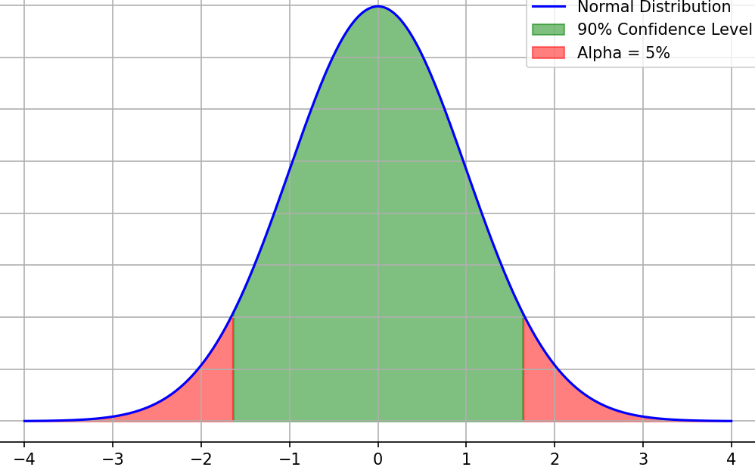
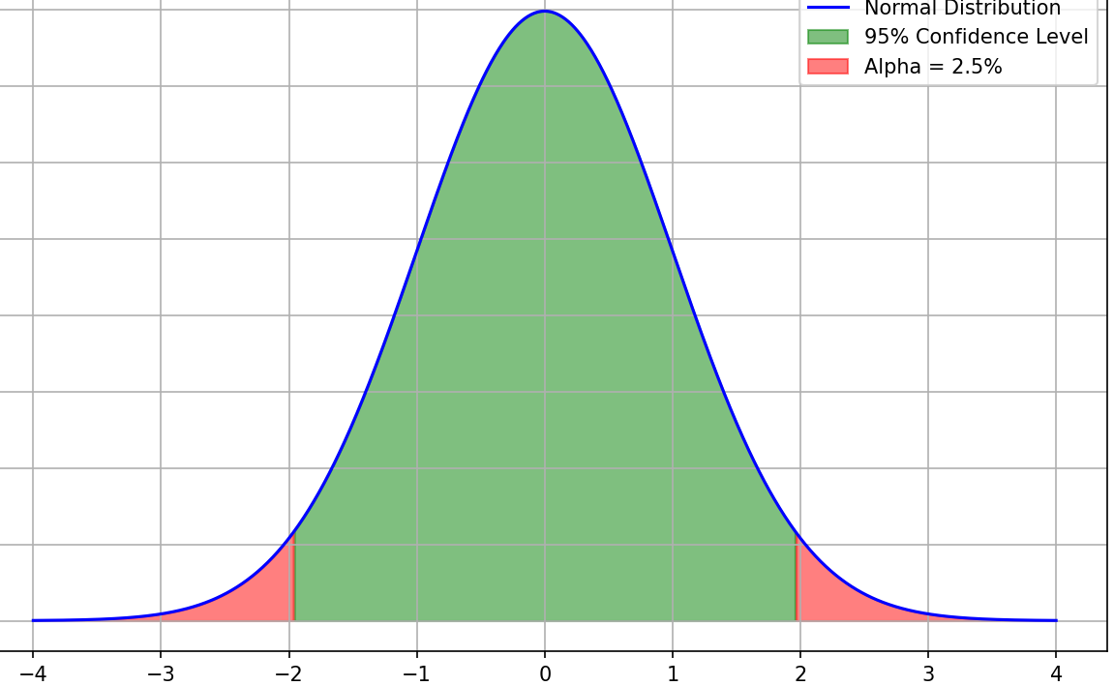
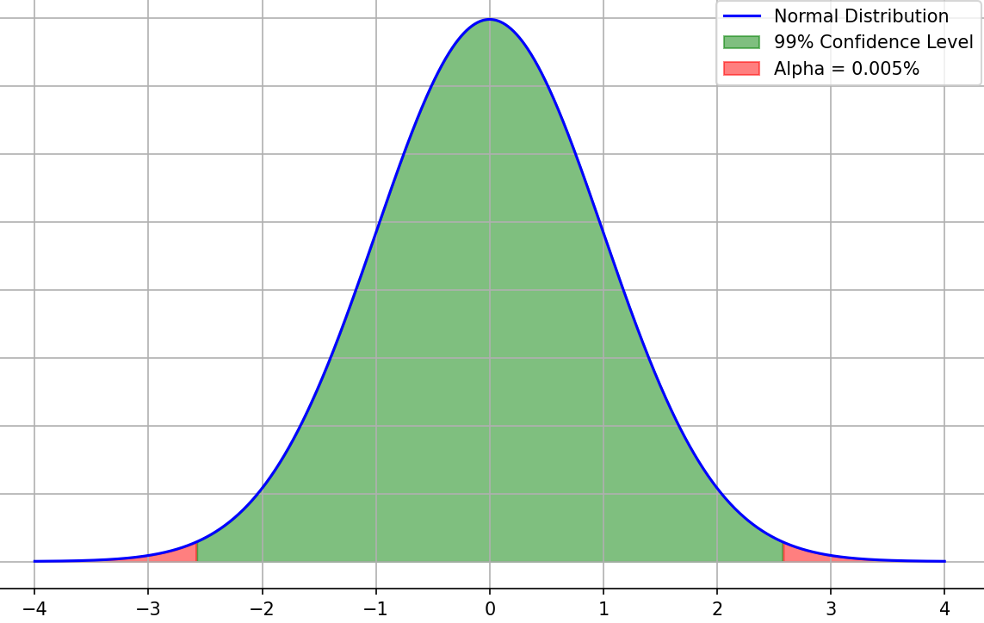
Significance Level and Confidence Level
As the confidence level increases, Critical Z-value increases
Confidence level = 90%
Significance level (α) = 10%
Critical Z-Value = ±1.64
Confidence level = 95%
Significance level (α) = 5%
Critical Z-Value = ±1.96
Confidence level = 99%
Significance level (α) = 1%
Critical Z-Value = ±2.58

Slide 19
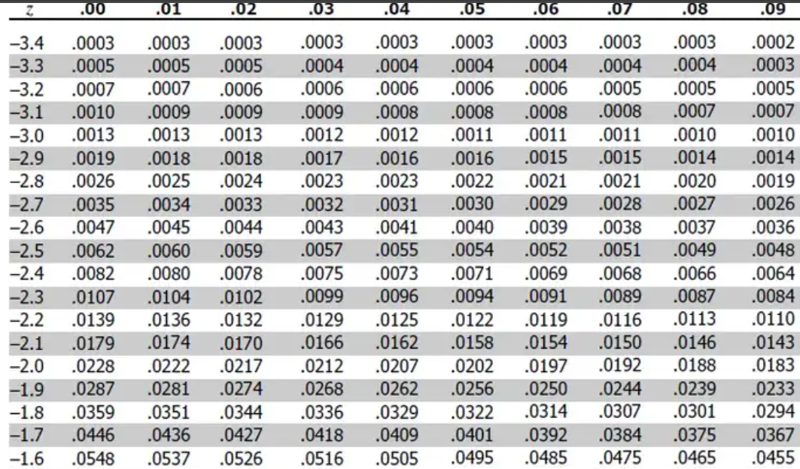
How to Get Critical Value from Z-Table
Look for our probability value
That is 0.025
Critical value = Row + Column
Critical value = 1.9 + .06
Critical value = 1.96
Note: If we look in the positive Z-table (the second table on the same page, we will need to look for 1 – 0.025, i.e. 0.975 and we will get the same result, i.e. 1.96)

Slide 20
Type I, II Errors, Alpha Beta
 | H0 is True | H0 is False
Reject H₀ | Type I Error, Alpha | Correct
Do not Reject H₀ | Correct | Type II Error, Beta
Why can this happen? Bad sample data …
Example: We got a bad sample where Average sample score = 80
We would reject H₀ because in our sample it seemed so, although in general it is true, considering all the other samples
Note: Try to reduce Type I errors => Try not to reject H₀ (See table above)
But it automatically means a scope for increase in Type II errors (See table above)

Slide 21
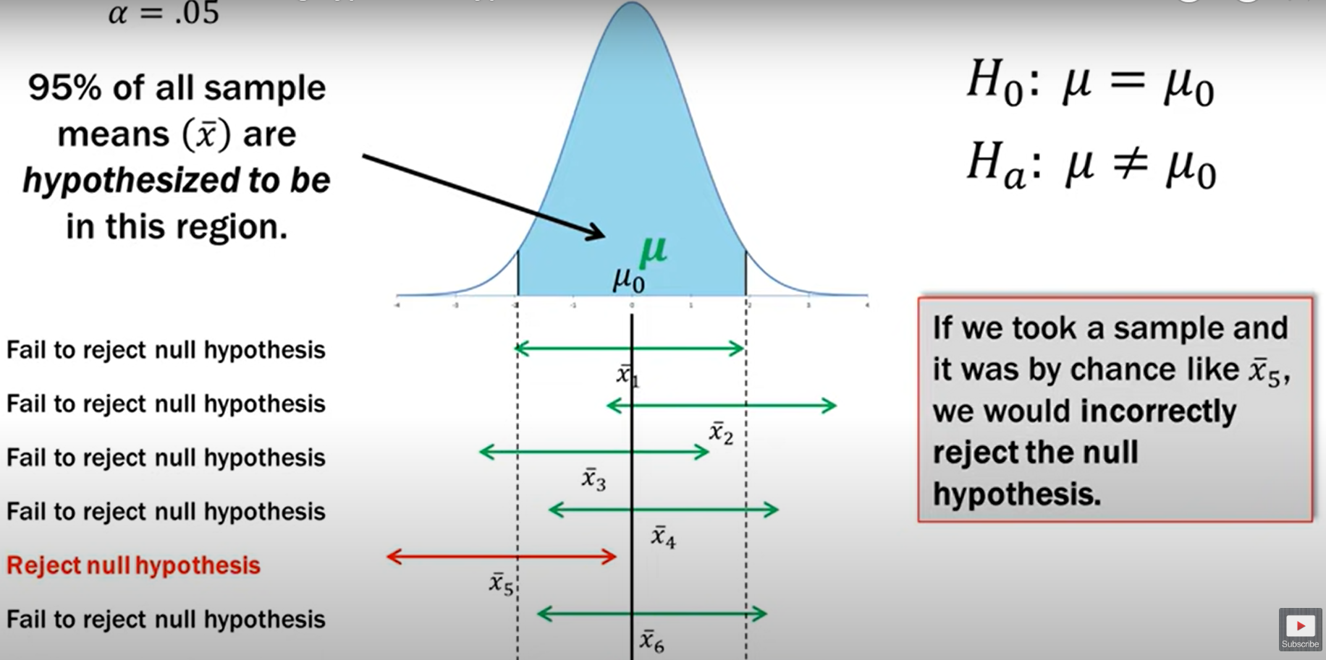
Visualizing Type I Errors
According to all the other samples, we will fail to reject H0, which is correct
Meaning: If by chance, the only sample we tested was x̄₅, we would commit Type I error
Type I error

Slide 22
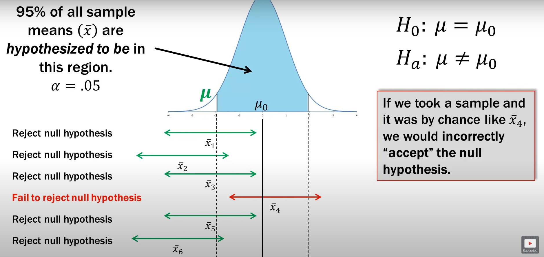
Similarly, Type II Error Now
According to all the other samples, we will reject H0, which is correct
Meaning: If by chance, the only sample we tested was x̄₄, we would commit Type II error

Slide 23
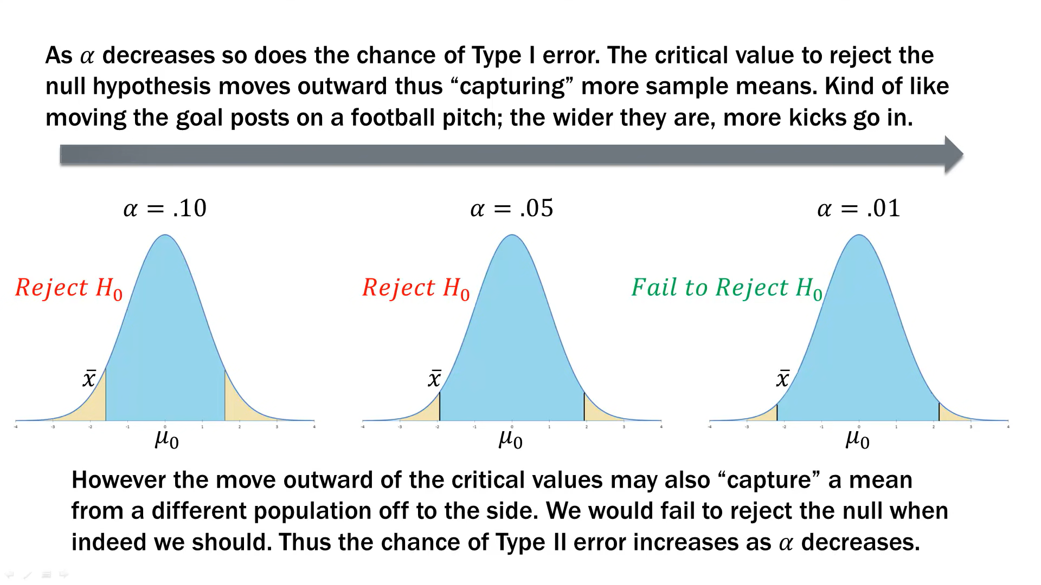

Slide 24
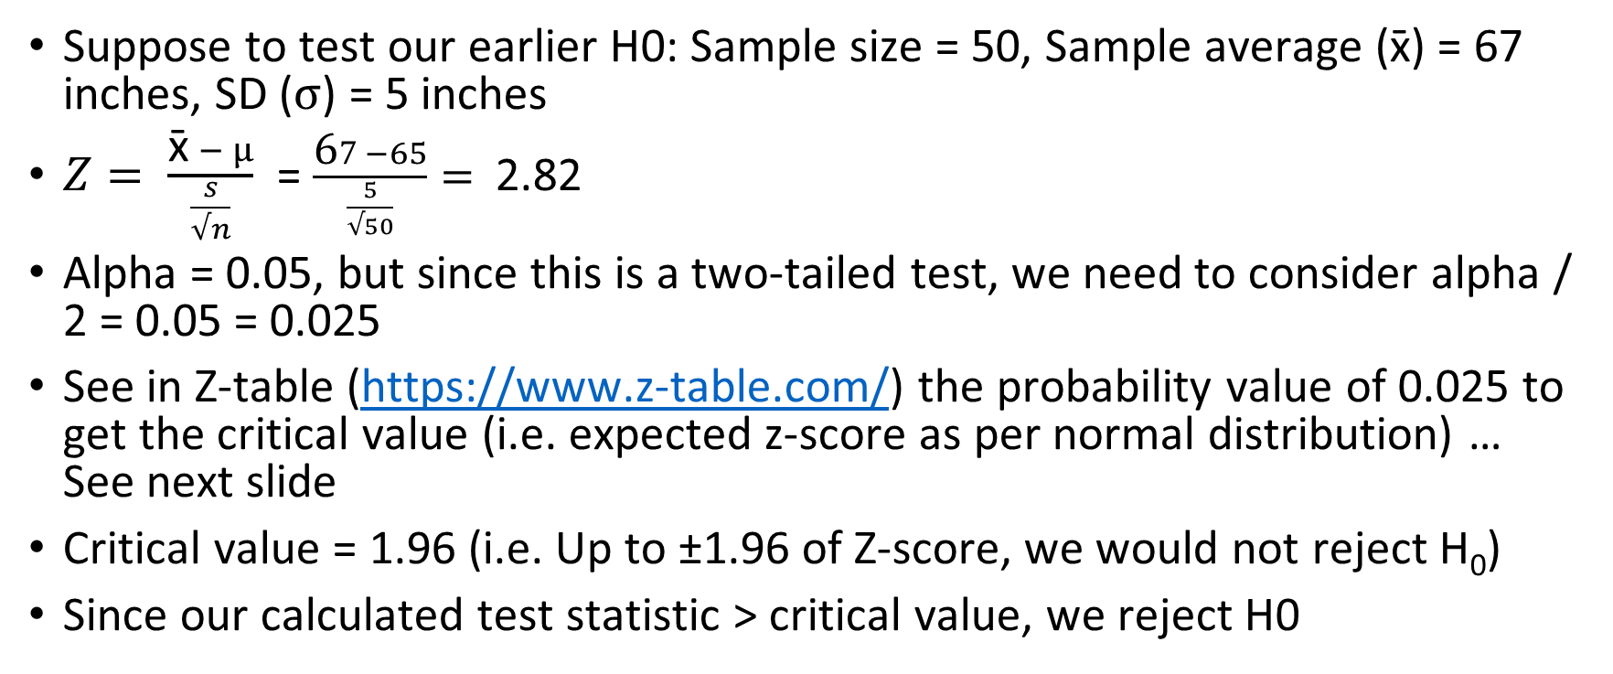
Calculate Test Statistic
Suppose to test our earlier H0: Sample size = 50, Sample average ($\text{x}\text{̄}$) = 67 inches, SD ($σ$) = 5 inches
$Z= \frac{\text{x}\text{̄} − μ}{\frac{s}{√n}}$ = $\frac{\text{6}7 −65}{\frac{5}{√50}}=$ 2.82
Alpha = 0.05, but since this is a two-tailed test, we need to consider alpha / 2 = 0.05 = 0.025
See in Z-table (https://www.z-table.com/) the probability value of 0.025 to get the critical value (i.e. expected z-score as per normal distribution) … See next slide
Critical value = 1.96 (i.e. Up to ±1.96 of Z-score, we would not reject H₀)
Since our calculated test statistic > critical value, we reject H0

Slide 25
p-value
p-value = Area of rejection
Low p-value: Reject H₀, High p-value: Fail to reject H₀
Example: A pizza outlet claims they deliver pizza in <= 30 minutes on average
H₀: Mean delivery time = 30 minutes
H_{a}: Mean delivery time <> 30 minutes
We test a few sample delivery times and get a p-value = 0.001
Since 0.001 is much less than 0.05, we reject H₀

Slide 26
p-value
p-value = Area of rejection
Low p-value: Reject H0, High p-value: Fail to reject H0
In our example, Z-score = 2.82
Go to Z-table and look for 2.82 … We see 0.9976 … So, this Z-score is at the 99th percentile … Which means only 1 - 0.9976 = 0.0024 or 0.24% values are above it … Here p-value = 0.0024 … But since it is a two-tailed test, we need to take 2 x p-value = 2 x 0.0024 = 0.0048
We can also use a ready calculator to get the same result: https://www.socscistatistics.com/pvalues/normaldistribution.aspx
Interpretation: If our null hypothesis were true we would expect to see a Z-value of 2.82 only in 0.48% of cases just due to random sampling variability
Since p-value of 0.0048 < alpha of 0.05, we reject H0

Slide 27
Conclusion
Fail to reject H0

Slide 28
Critical Values for Different Levels of α
Approximate Critical Values
α | Left-Tailed Test | Right-Tailed Test | Two-Tailed Test
0.1 | -1.28 | +1.28 | -1.64 and + 1.64
0.05 | -1.64 | +1.64 | -1.96 and + 1.96
0.01 | -2.33 | +2.33 | -2.58 and + 2.58

